Slide 1
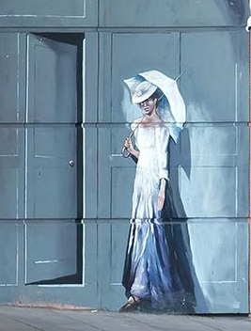
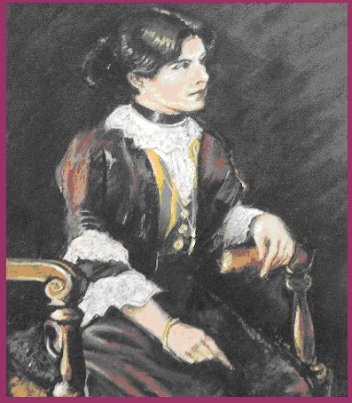
Eileen O’Leary
Who was she?
What can we find out
about her?
Notes:
Why should we want to find out about Eileen O’Leary?
Because she grew up in the Milford Street area.
She went to school and later worked in Salisbury.
Because she sailed on the Titanic.
To find out more about the Titanic, see the presentation with these resources.
To find out about Eileen O’Leary you will need to think like a detective; searching for evidence, examining it, and coming to your own conclusions.
There are many documents in this presentation that you can print off and use in group work for practice in using evidence.
1

Slide 2
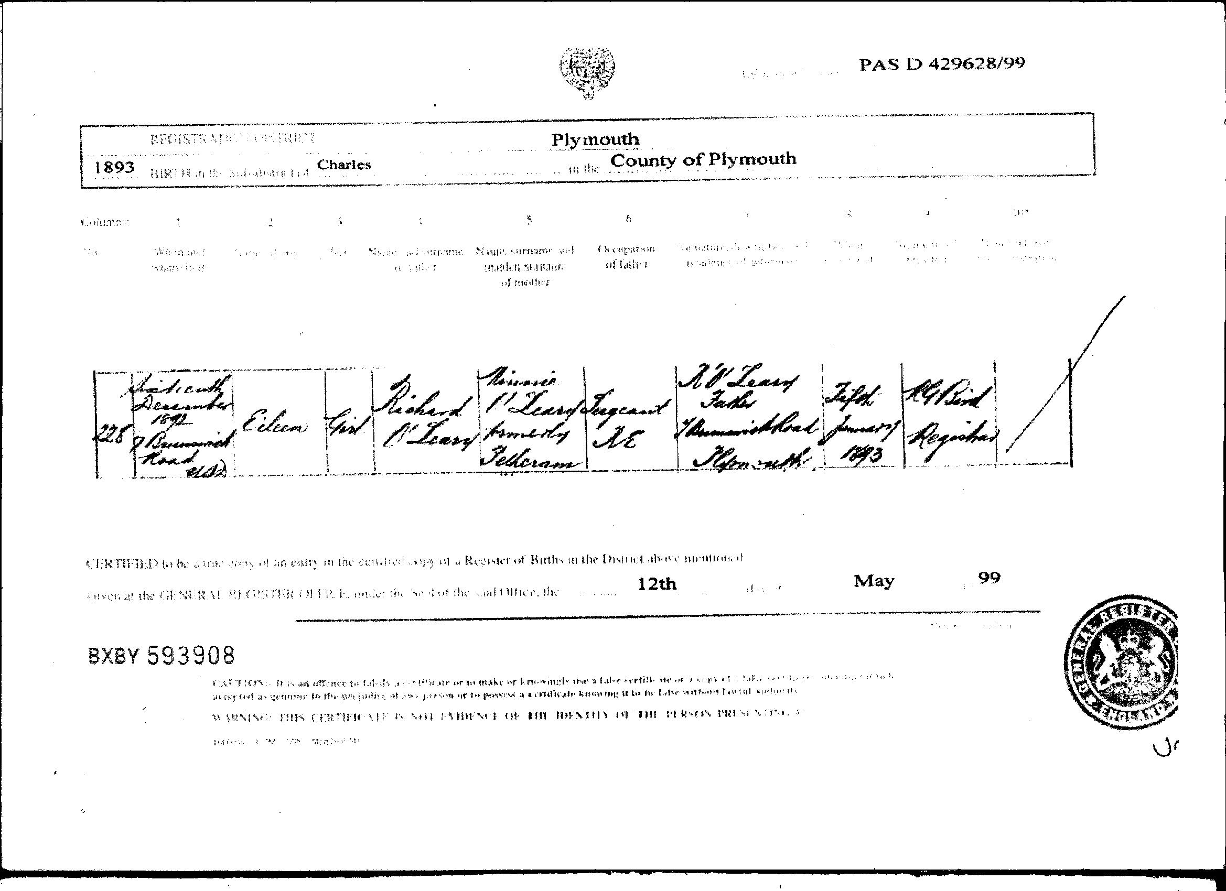
Notes:
This is our first piece of evidence: Eileen’s birth certificate.
Look to see what date she was born (2nd column).
Her father’s name is in the 5th column.
Her mother’s name is in the 6th column.
Can you find out where she was born?
Print these documents off and ask children to work in groups. It would be helpful if pupils were provided with magnifying glasses.
2

Slide 3
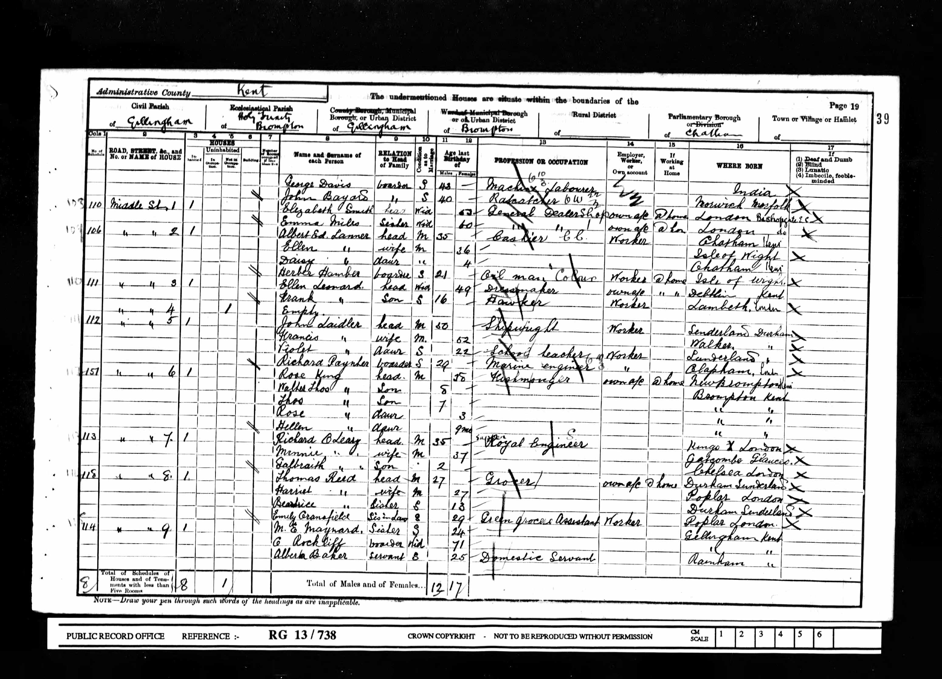
We can find evidence of Eileen and family from the Gillingham Census for 1901. Eileen’s father, mother and brother were recorded as living at 7 Middle Street.
Notes:
Our next piece of evidence is the Census for 1901.
(Census returns are made every 10 years and give the age, occupation and place of birth of every person in the country.)
In 1901 the family lived in Gillingham in Kent.
This is a page from the census return for Gillingham in 1901.
Can you find the O’Leary family?
What was her father’s age?
What was her mother’s age?
How old was their son and what was his name?
Can you find out what job her father did?
Find the name of the street where they were living.
But there is no sign of Eileen …..
3

Slide 4
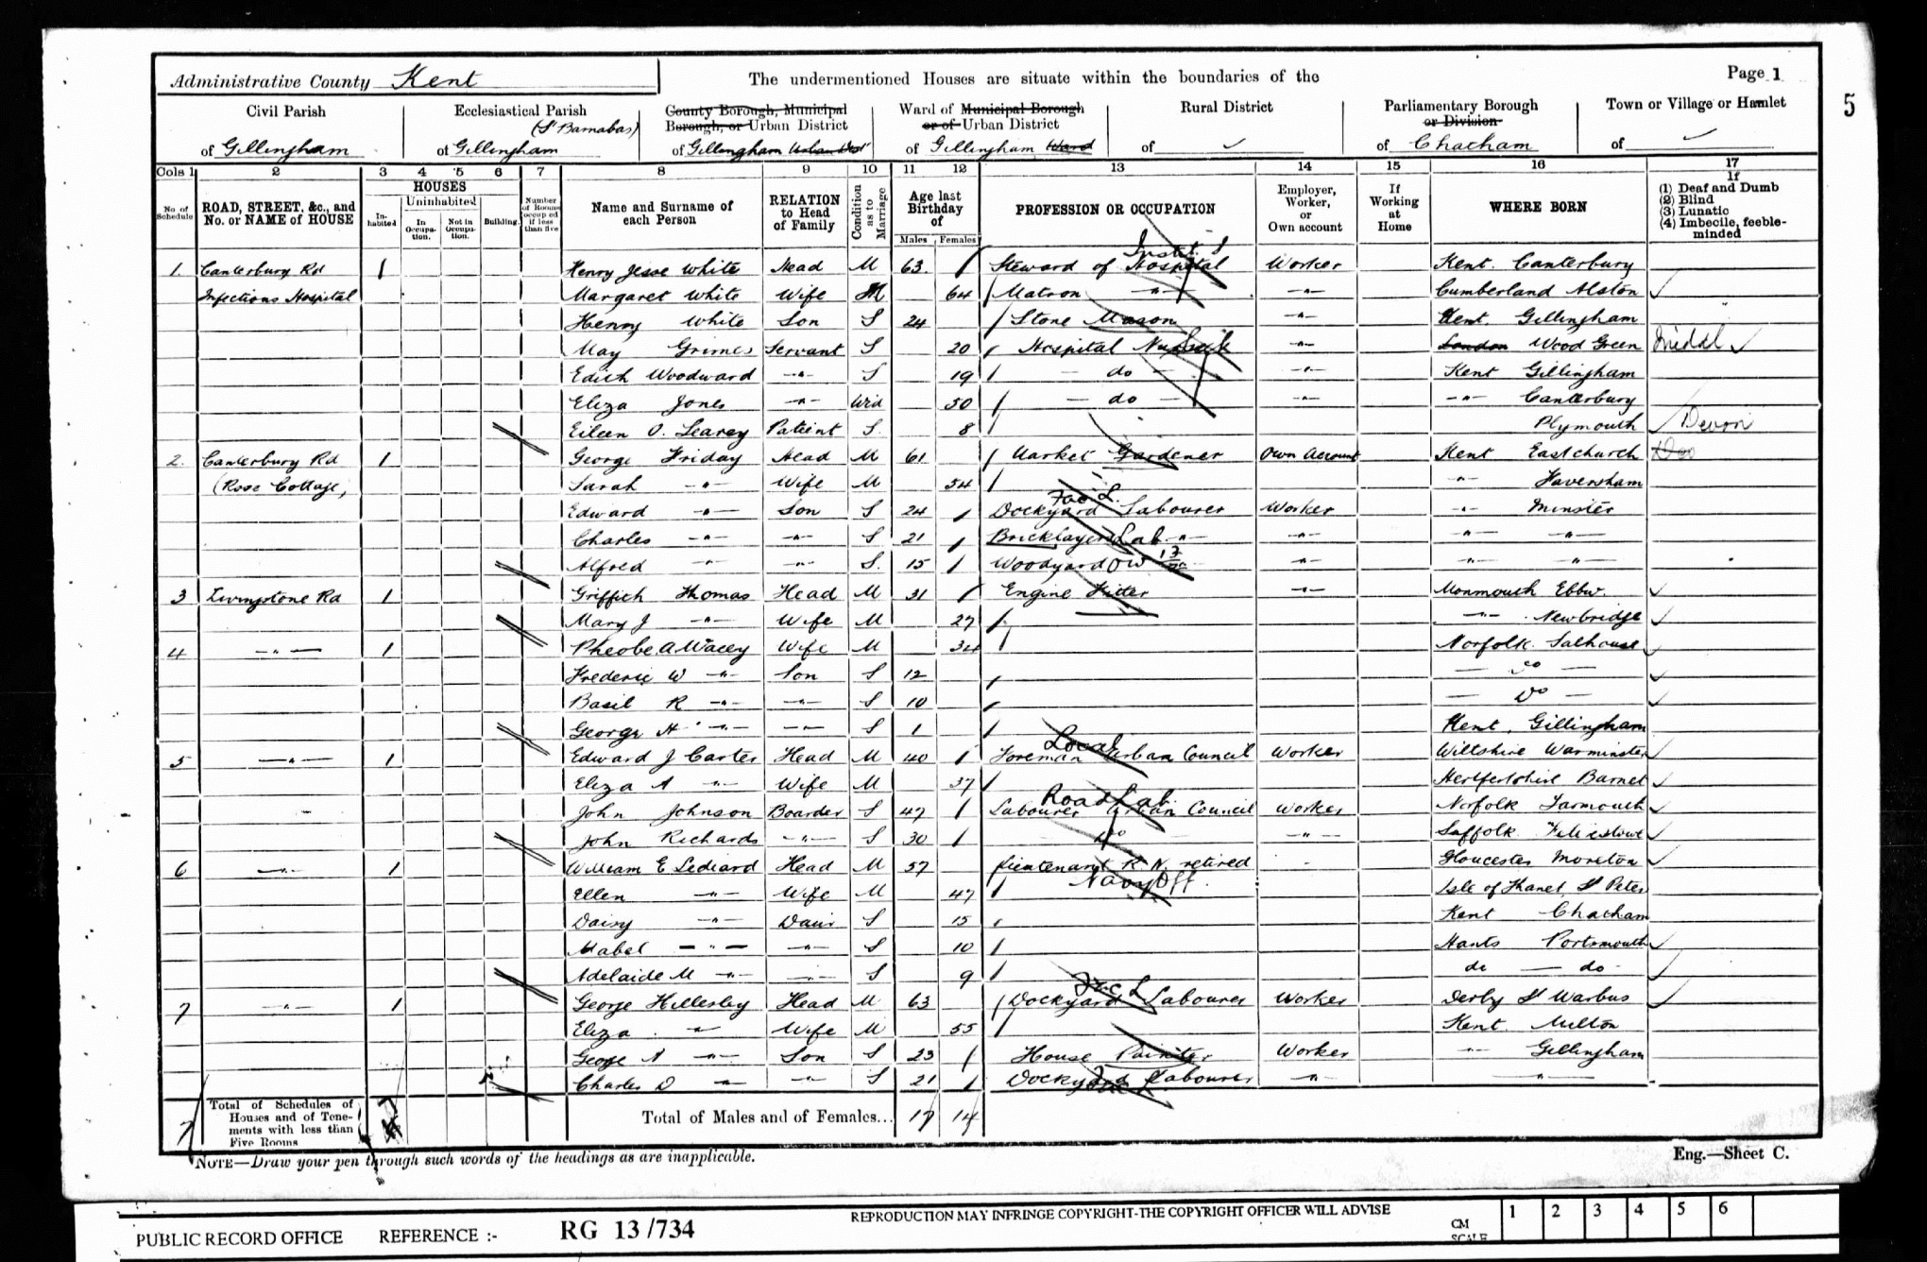
Eileen was not at home on the day of the census.
Notes:
Look at the census carefully and find Eileen.
Where is she and why do you think she was not at home?
(She was in Gillingham’s ‘Infectious Hospital’)
What do you think might have been wrong with her?
How old was she?
How do you think she felt being there?
Already you know quite a lot about Eileen.
And it has all come from the census returns.
4

Slide 5
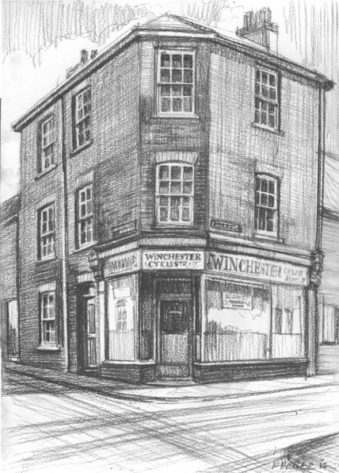
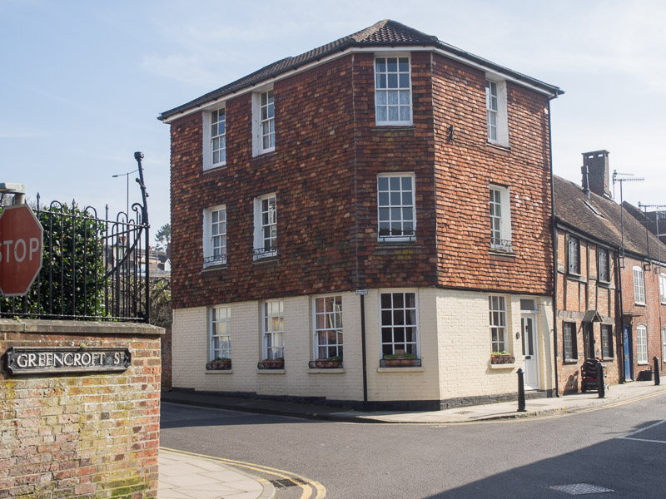
Then…
Eileen’s house
… and now.
Notes:
At the end of 1901 Eileen and her family moved to Salisbury. The lived in Winchester Street, where Richard and Minnie ran ‘The Cyclists’ Rest’.
This building is still there today.
Why might this be a good place to have a business like this? (The clue is in the name ‘Winchester Street, a major route in and out of Salisbury)
5

Slide 6
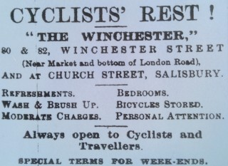
Notes:
Cycling was a popular hobby, and lots of people cycled into Salisbury regularly to do their shopping. The Cyclists’ Rest would have been a busy place.
What did the Cyclists’ Rest have to offer?
Why were bicycles so popular then? (Very few people had cars. Bicycles are easier to park and leave, and cheaper to run, than a horse and cart!)
6

Slide 7
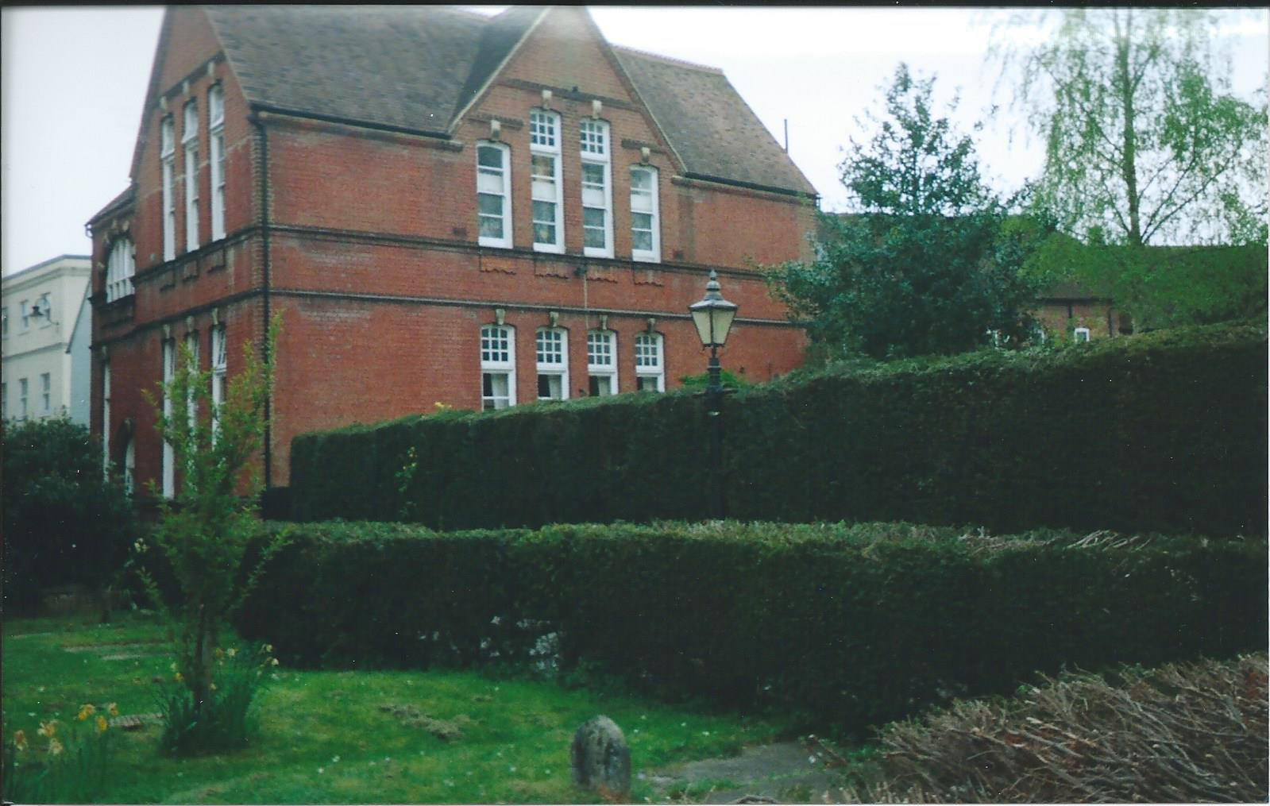
Eileen went to St. Thomas’s School, Salisbury
Notes:
Eileen’s school is still there, near St Thomas’s Church in Salisbury.
Today it is a restaurant “Cotes Brasserie”.
From the outside it looks rather forbidding.
The windows are large (to let in light when there was no electric light)
and high (to stop children wasting their time looking out!)
There was little room to play outside.
What games do you think Eileen and her friends could have played outdoors?
7

Slide 8
Maths for 12 year olds in about 1905
1. Multiply six millions five hundred and eighty three thousand and twenty by 6,309 and divide this product by 701 (Answer in figures)
2. Add together 75 tons 3 cwt 10 Ibs: 33 tons 1 cwt 161bs & 125 tons 2 cwt 3 qrs 2 lbs. What is the value of the whole at 5s. 7d per qrs.
3. A cistern containing 60 gallons is one third full; the supply pipe conveys into the cistern 21 gallons a minute and a discharge pipe lets out 1gal 3 qts a minute. If these two pipes are opened at the same time in what time will the cistern be full?
4. How many yards worth 4s. 2d a yard must be given in exchange for 402 yards at 3s. 5d a yard?
5. Divide £89.17.6d by 19.75
Notes:
This is a page from an arithmetic test like the one Eileen would have had to take when she was 12 years old.
Maths was more complicated because money was different then:
There were 4 farthings or 2 halfpennies in a penny,
There were 12 pennies in a shilling,
There were 20 shillings in a pound.
A guinea was one pound and one shilling.
How many pennies in a pound?
How many farthings in a shilling?
Do you think Eileen and her friends had calculators to help them? (No!)
Eileen would also have learnt reading and writing, drawing and sewing at school.
8

Slide 9
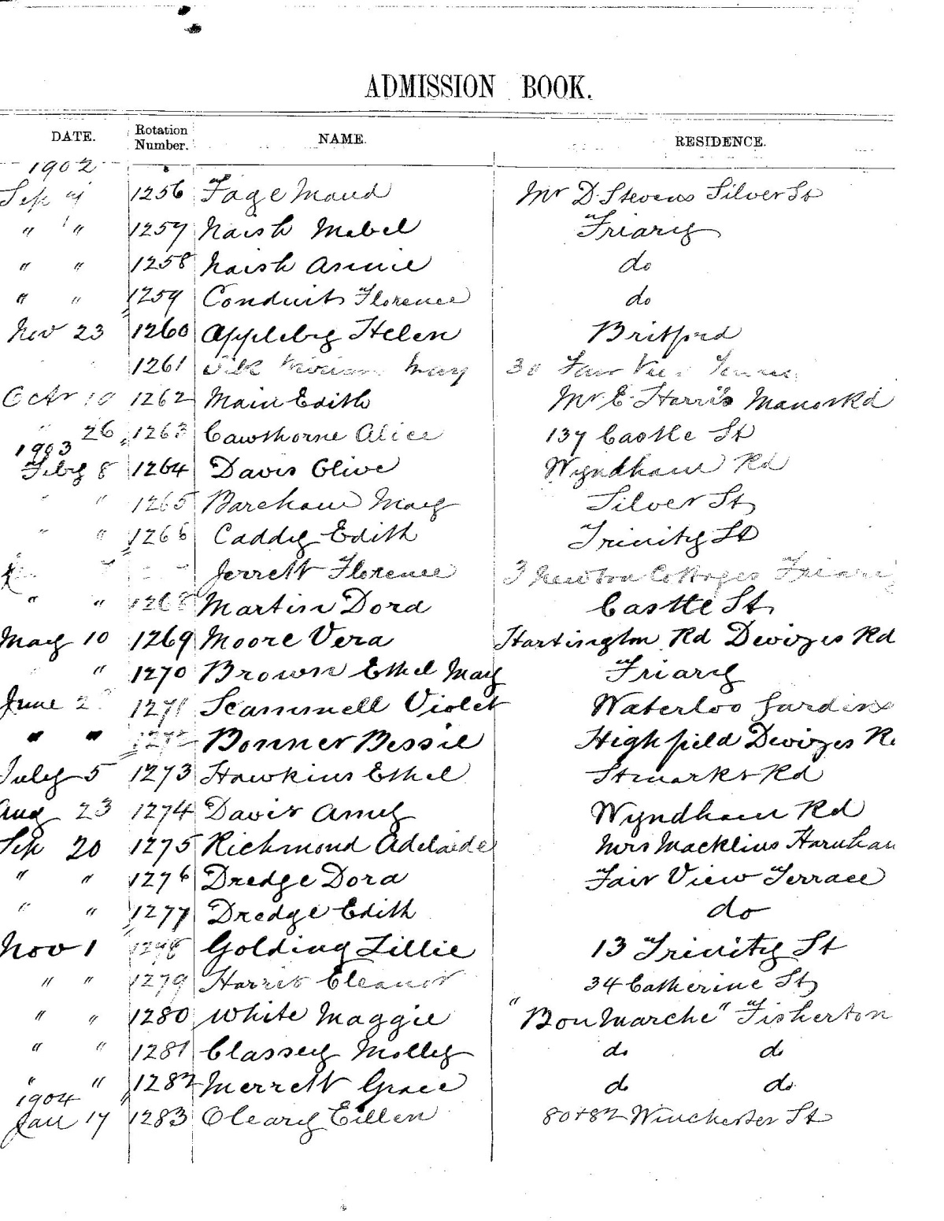
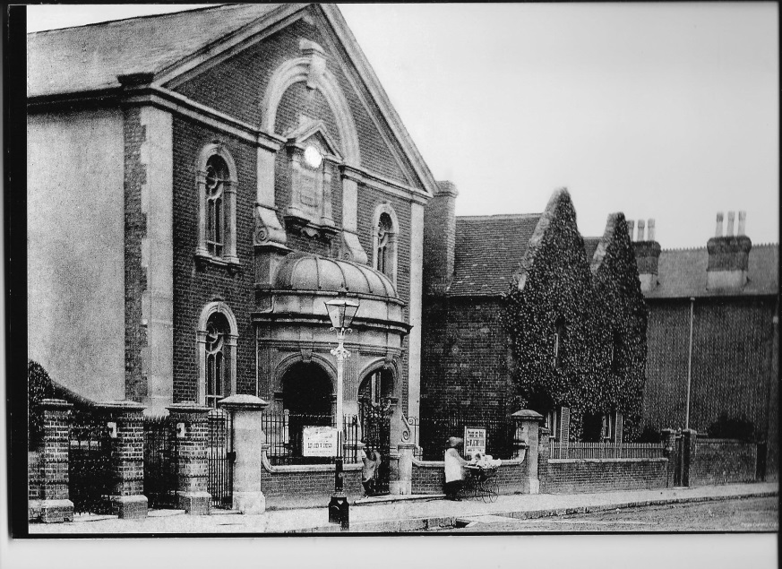
What did Eileen do on Sundays?
Brown Street Baptist Church
Notes:
Can you prove that Eileen went to Sunday School?
See if you can find her name on this page from the Admissions Book of the Brown Street Sunday School.
When did she first start there?
How old was she then?
When she left she was given a copy of the New Testament.
9

Slide 10
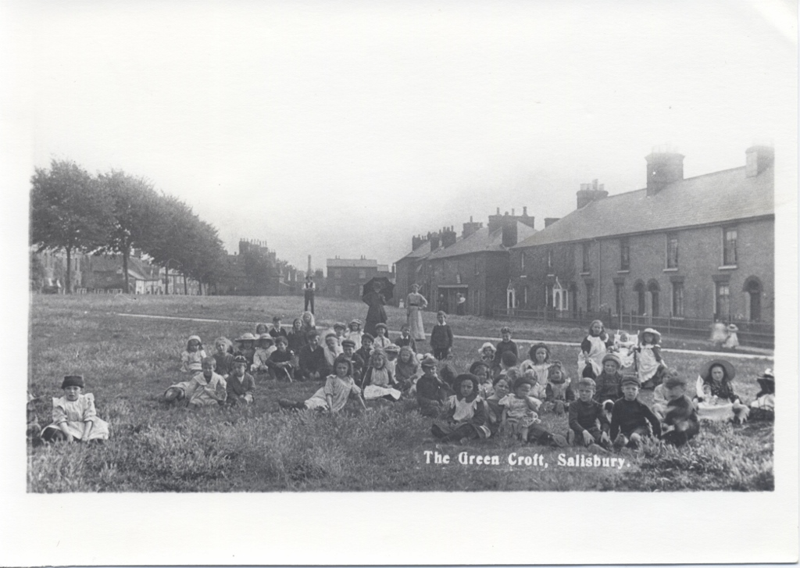
What might Eileen have looked like as a child?
© Peter Daniels
Notes:
This photograph was taken in 1901 or 1902.
Eileen would have been about 8 or 9 years old then .
The photographer has invited the more clean and tidy children to be photographed! Eileen may well have been one of them.
Which one do you think might be her?
What makes you think so?
Small boys wore dresses like the girls until they were four or five.
Can you spot a boy older than five in this photograph?
How about one in skirts?
10

Slide 11
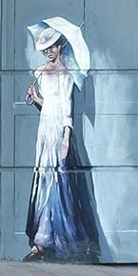
How might she have looked when she was grown up?
Notes:
Eileen had her photograph taken when she was a bit older, before she left home (on left of screen)
The other two pictures are artist’s impressions of how she might have looked. How accurate do you think they are?
There were no teenage clothes in those days.
At about 14 years old Eileen would have gone straight from wearing children’s clothes to wearing a tight corset and long skirt.
(a corset was made of linen with whalebone strips sewn into it. It was laced tightly from chest to hips to make the wearer look straight and slim.)
What do you think would be different if you had to wear a corset? (behaviour, posture, appetite, comfort)
11

Slide 12
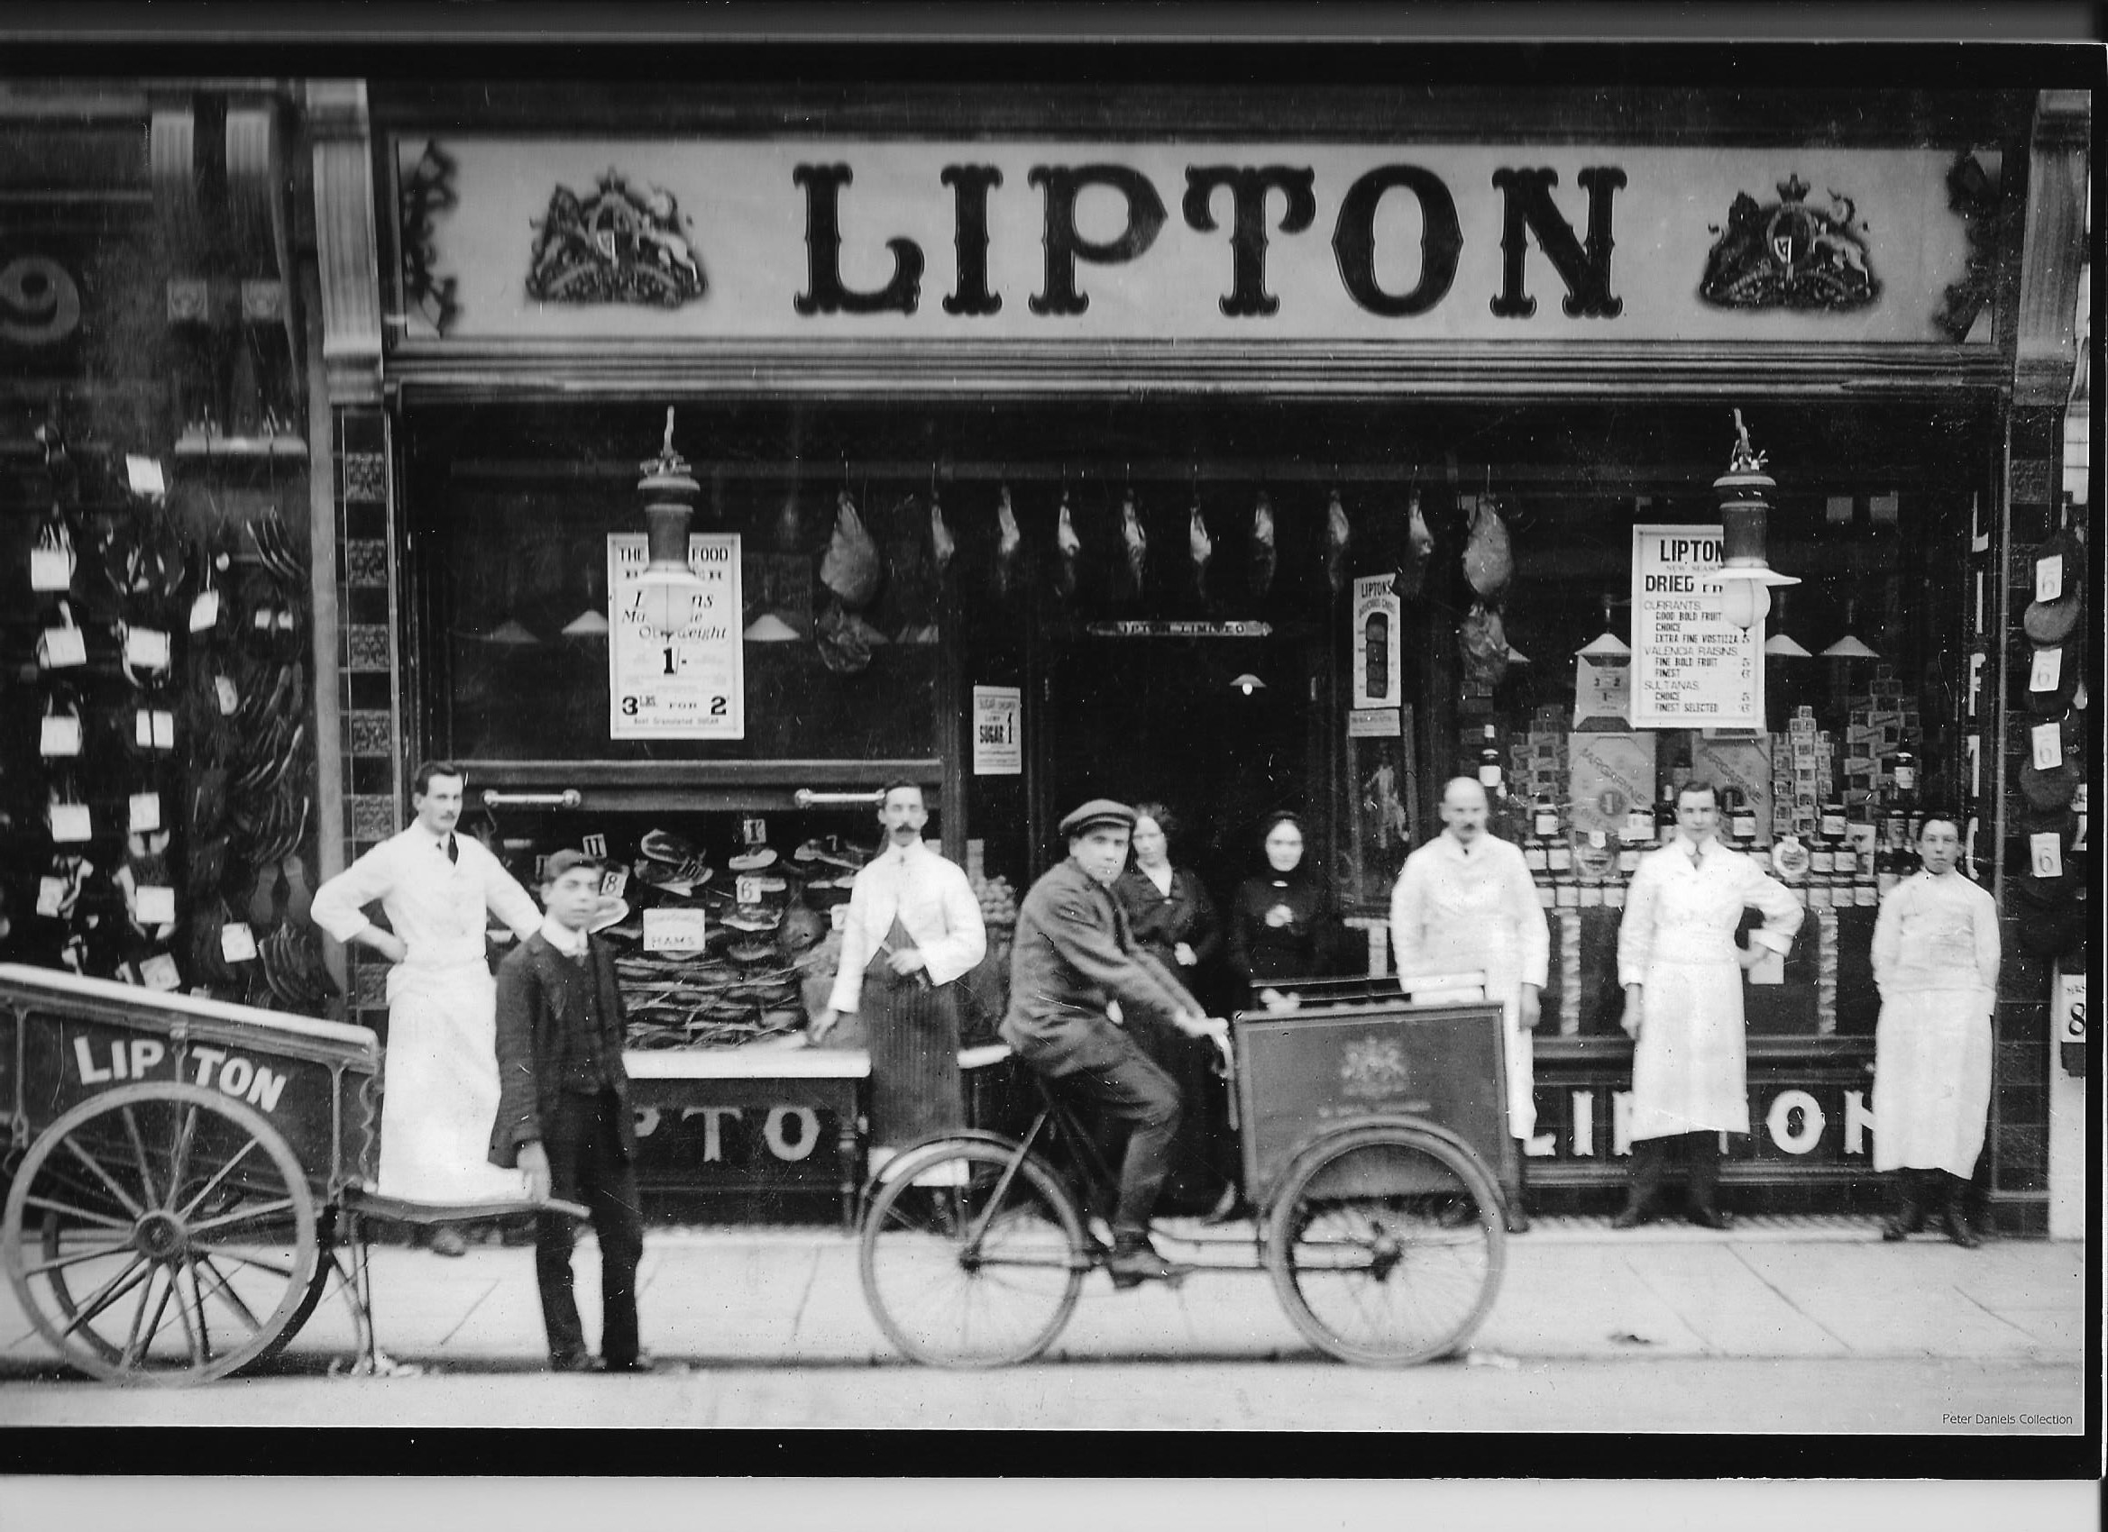
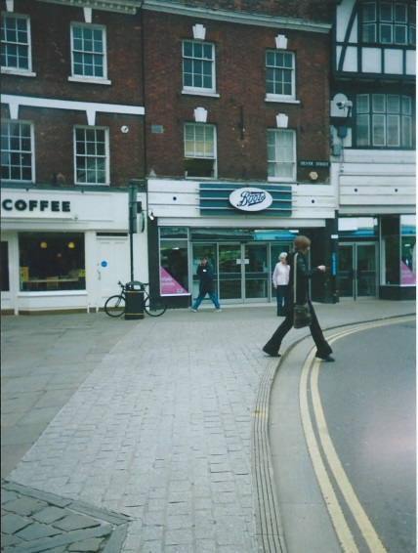
Notes:
When Eileen was 14 years old she left school and got a job as a cashier at the busy Liptons Grocery Store. (In Salisbury, where Boots is now)
Eileen was given a job as a cashier. That means she had to deal with the money.
What would she use to help her add up the grocery bills? (Pencil and paper)
Could you use this as evidence that she was good at Maths?
12

Slide 13
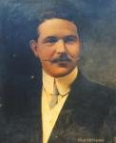
Eileen worked there for four years. She and the manager, Neal NcNamee fell in love.
They got married on January 17th 1912
Neal McNamee with his fashionable waxed moustache!
Notes:
Have a look at Neal McNamee’s portrait. What does it tell you about him? (smart, fashionable, cared about his appearance, confident…)
Look again at his clothes.
How would you feel wearing a stiff collar like that?
100 years ago collars were not sewn on, so they could be changed when dirty without washing the whole shirt.
Neal was good at his job.
Mr Lipton offered him a job in New York as an assistant manager.
He would sell tea, coffee and ham to American shops.
13

Slide 14
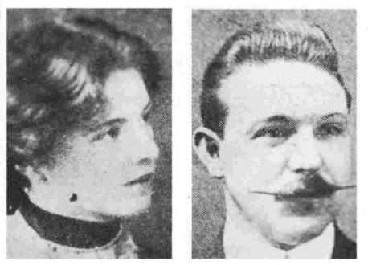
Notes:
Eileen’s mother Minnie helped her to pack. We know she packed a blue skirt and a white “sailor” blouse with a blue anchor sewn on it. There was a New Testament in her case too. (Do you remember where it came from?)
Minnie said goodbye to them both in Salisbury. Richard and Eileen’s brother Gallie went with them to Southampton docks and waved them goodbye.
How would you have felt if you were going to travel on the maiden voyage of such a beautiful, big, new ship like the Titanic?
Do you think they felt the same?
14

Slide 15
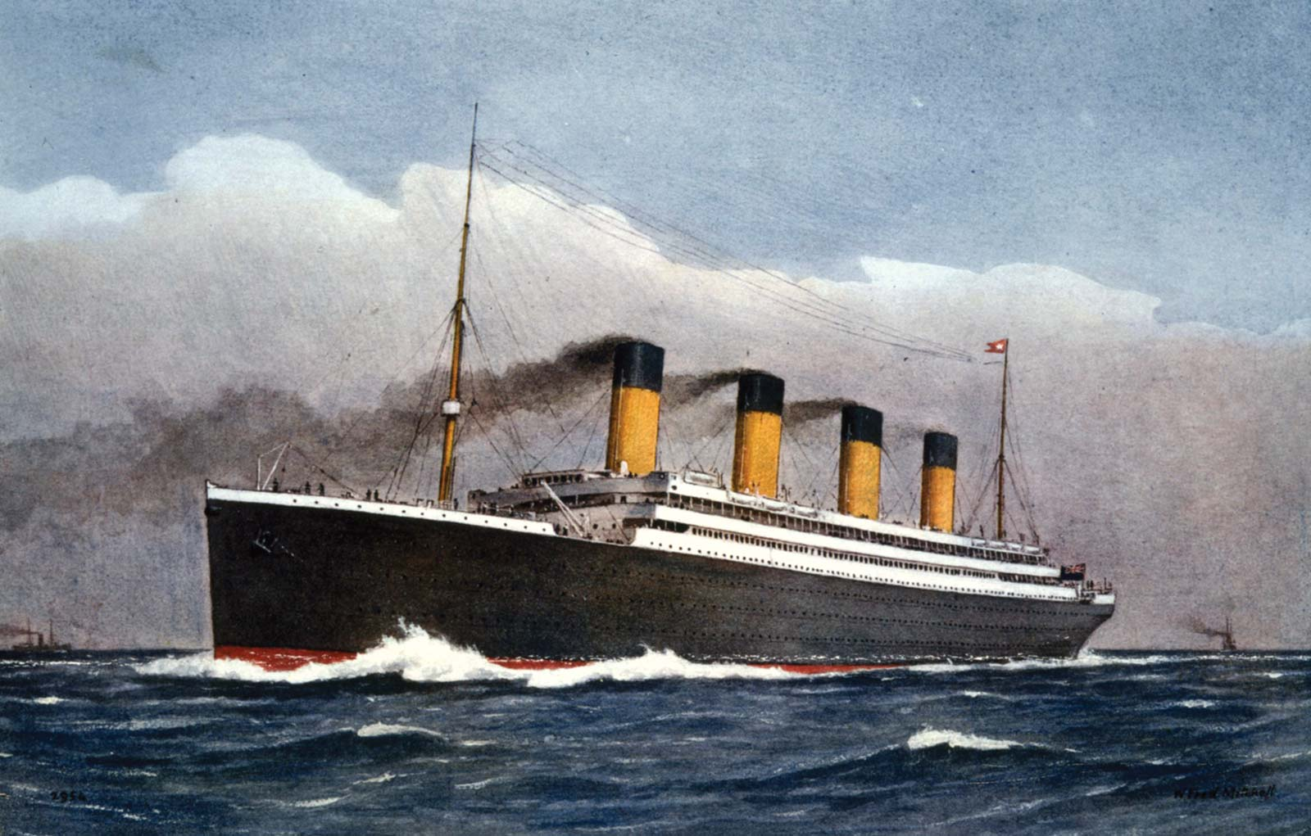
© Encyclopædia Britannica
Notes:
On April 12th 1912 the young couple, now Mr and Mrs McNamee boarded the Titanic in Southampton and set off for their new life.
They were emigrating to America. They knew they might never see their families again (It cost so much to travel across the Atlantic - no cheap flights then).
What does that tell us about Eileen? (Brave? Adventurous? Very much in love?)
15

Slide 16
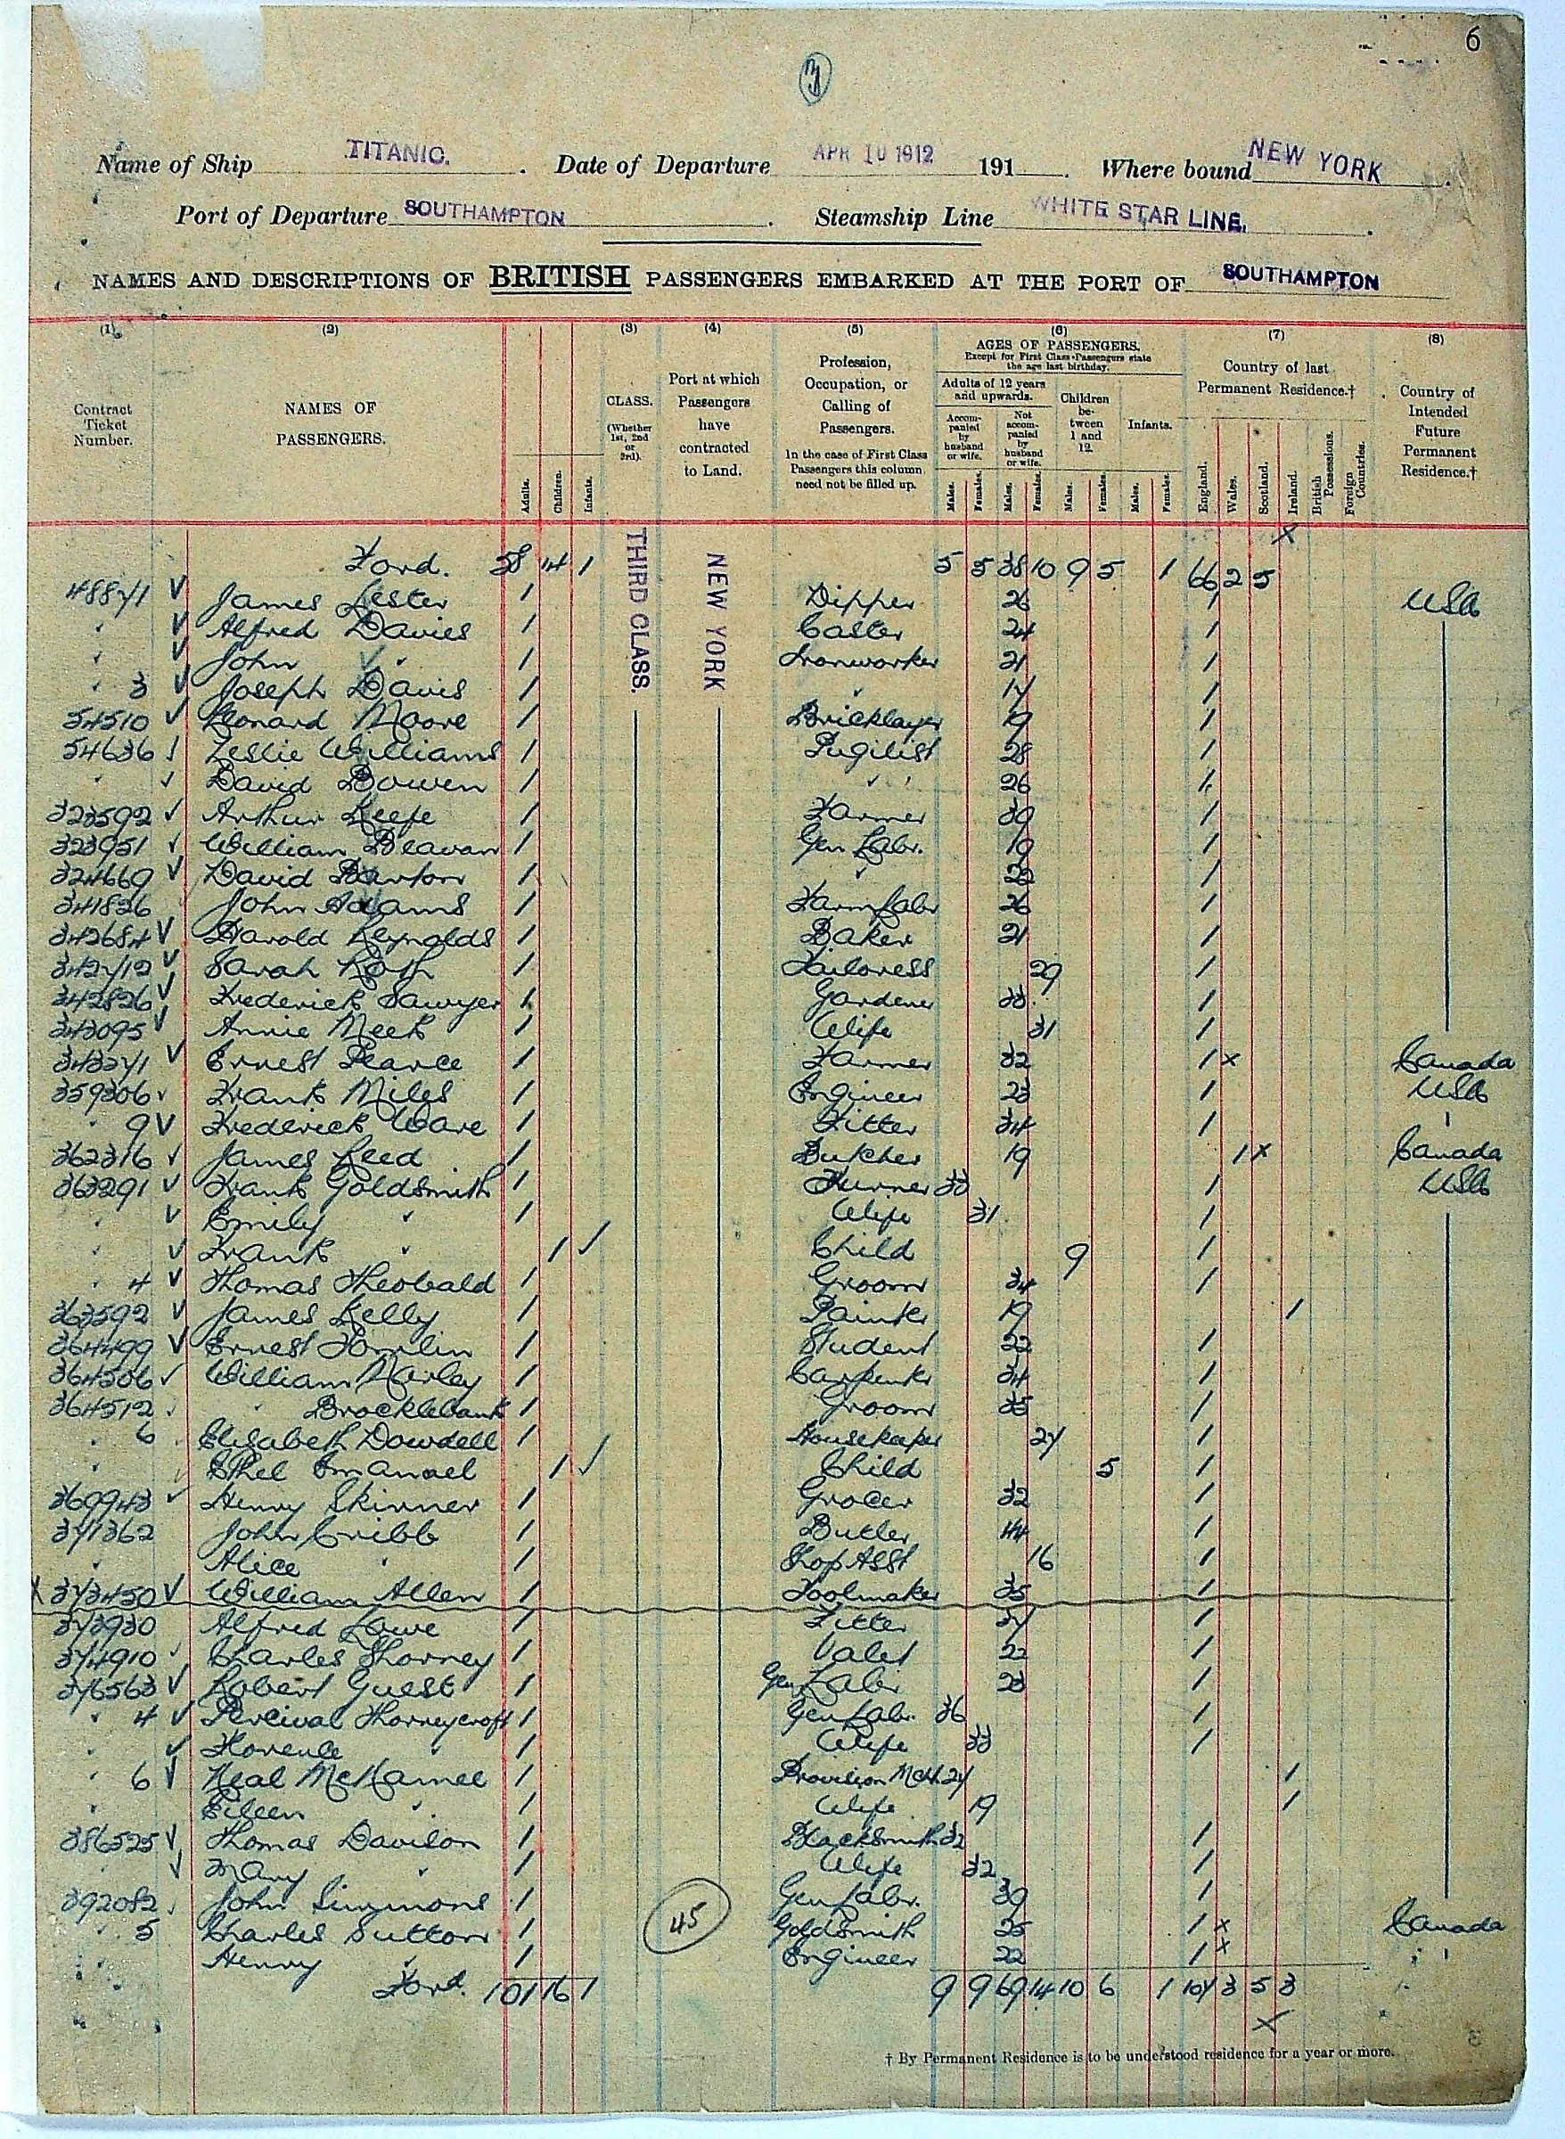
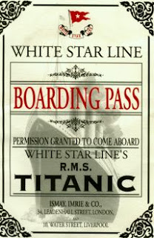
But can we prove that Neal and Eileen McNamee were on board?
This is a page from the Titanic’s Passenger List
Notes:
http://www.encyclopedia-titanica.org/titanic-third-class-passengers/
The Passenger List is useful evidence - but rather hard to read. (Eileen and Neal’s names are near the bottom.)
You can find out more about them by clicking on their names.
This is a good opportunity to work from documentary evidence.
Here are several questions pupils could explore:
How much did their tickets cost?
How old was Neal McNamee?
Where was he born?
Why were he and his wife travelling to America?

Slide 17
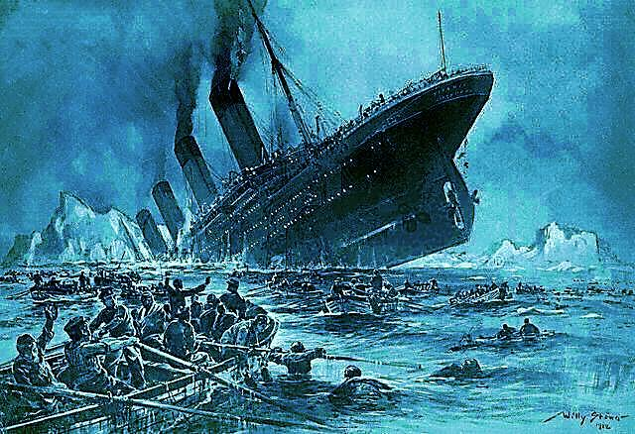
But the ‘unsinkable’ ship hit an iceberg and sank.
Notes:
The unthinkable happened and the Titanic sank with a loss of 1,517 lives.
The iceberg ripped through the hull in several places.
No one had imagined that she would ever be so badly holed.
You can find out more from the Titanic presentation
which is part of these resources.

Slide 18
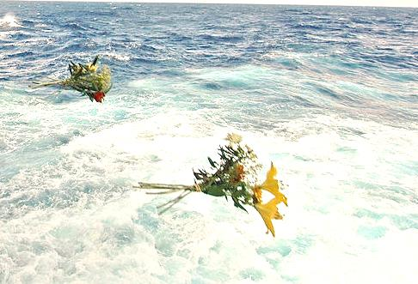
What happened to Neal and Eileen?
Neal’s body was never found. Like many brave men he would have helped women and children into the boats and stayed on board the sinking liner.
Eileen’s body was recovered
by the ship the MacKay Bennett .
She was buried at sea.
Notes:
Why did men like Neal McNamee let the women and children take the lifeboats?
How do you feel about that?
Was it the right thing to do?
Poor Eileen, like many others, did not survive the cold water.
18

Slide 19
‘….One young couple walked steadily up and down
the boat deck throughout pretty well the whole of the proceedings. Once or twice the young chap asked if he could help. He was a tall, clean-bed Britisher, on his honeymoon I should say. The girl – she was little more – never made the slightest attempt to come towards the boats, much less be taken on board, although I looked towards her several times with a look of silent invitation, but no, she was not going to be parted from her man.’
Charles Lightholler, senior surviving officer , RMS Titanic
Notes:
What do you think of this eyewitness account?
Is there any evidence that makes you think the young couple might have been Eileen and Neal?
(‘young couple’…’Britisher’ … ‘on his honeymoon’… ‘the girl – she was little more’)
There’s a tradition in Neal McNamee’s family that Eileen would not leave her husband to get on the lifeboat. How much can you rely on family traditions?
Do you have any family traditions?
Are they likely to be based on fact?

Slide 20
There is a short list of five young couples Lightholler might have seen, who were British or Irish, had no children with them, and are known to have both died: John and Elizabeth Chapman aged 30 and 28 Dennis and Mary Lennon aged 21 and 22 William and Cordelia Lobb aged 30 and 26 Neal and Eileen McNamee aged 27 and 19 William and Dorothy Turpin aged 29 and 27
Notes:
Which couple do you think Lightholler saw on the deck?
(Elizabeth Chapman, Cordelia Lobb and Dorothy Turpin were all a bit old to be called ‘a girl’.
That leaves the Lennons and the McNamees.
The Lennons weren’t married, they were eloping – he was a barman and she was the landlady’s daughter. They were frightened of being caught, and might have kept back.
Neal was a manager, confident, used to being in charge. He might well offer help to a ship’s officer.)
We can’t prove which one it was.
What do you think?

Slide 21
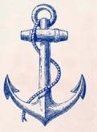
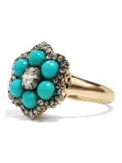
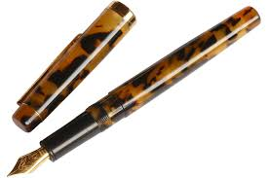
When Eileen’s body was found she was wearing a brown velvet coat, a white ‘sailor blouse’ with a small blue anchor on the front.
She had a blue flannel petticoat, blue corsets, a blue skirt trimmed with black braid, black stockings and shoes.
On her left hand she wore her wedding ring and a little turquoise and diamond ring, while on her right wrist was a bracelet.
She carried a purse with 1s 11d in it,
two third class tickets, a fountain pen and keys.
Notes:
These pictures give an impression of what Eileen’s things may have looked like – they are not actually hers.
Do you think Eileen had dressed to look fashionable for her sea voyage? (sailor blouse with anchor)
Flannel was a warm material suitable for days at sea.
Corsets were made of linen and strips of whalebone. Nearly all women wore them around their middles to give them good posture and a small waist.
Can you picture Eileen, dressed up for her sea voyage?
What do you think the keys were for? (cabin? suitcase?)
What is a fountain pen and why did she have one?
What else would she need to make it work? (ink)

Slide 22
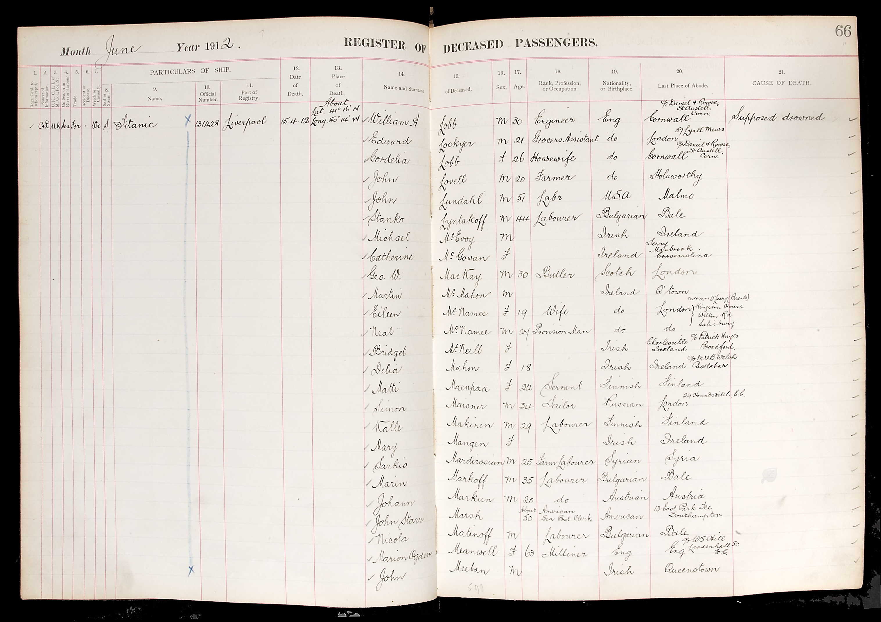
Portrait of Eileen from mural
Notes:
This is a register of passengers who did not survive.
Would this be good enough evidence that the McNamees didn’t survive?
What else can you find out about them from this register?
22

Slide 23
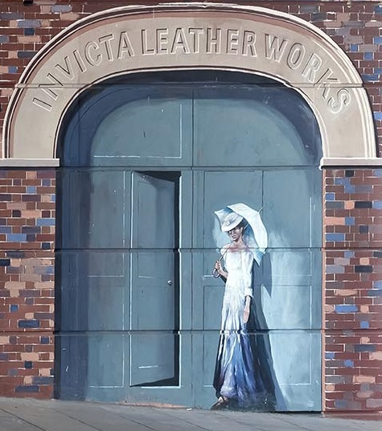
Notes:
Eileen is not forgotten in Salisbury. You can still see the house where she lived in Winchester Street, her old school, the church she went to and the place where Lipton’s Grocery Store was, where she used to work.
In Churchill Gardens you can find a bench and a tree by the side of the river walk put there in memory of Eileen .
You can find out more about the Titanic from the Titanic power-point presentation.
Titanic Dance and Drama lesson plans are available as part of these resources to help children express their ideas and feelings about Eileen and the Titanic.
In the MSBP Loan Box you will find ‘Eileen’s suitcase’. This is an evidence-based exercise in working with artefacts.
You can download and walk the Eileen O’Leary Trail, which you can find as part of these resources.

